Slide 1
NECS Consultancy Support to BNSSG
Inner City and East Bristol
31/10/2022

Slide 2
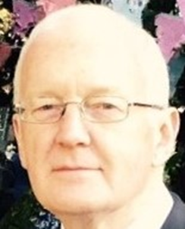
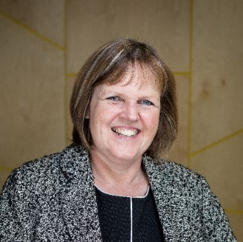
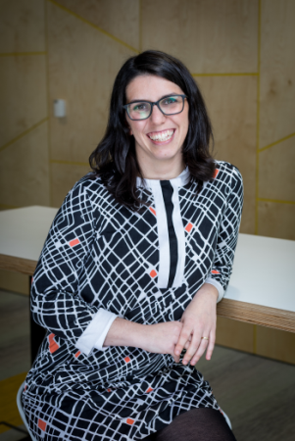
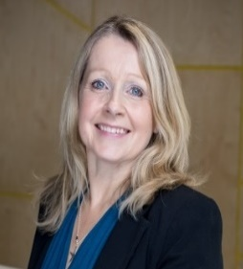
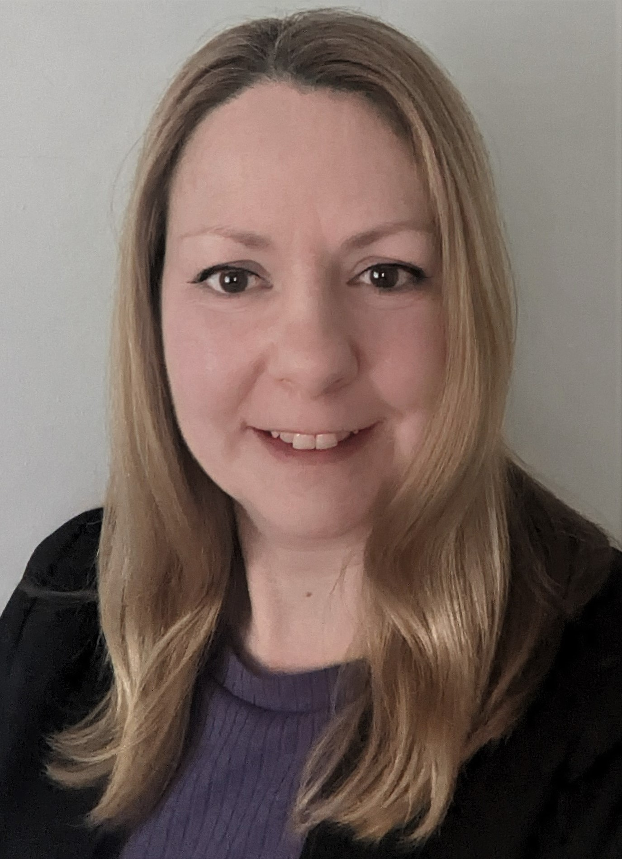

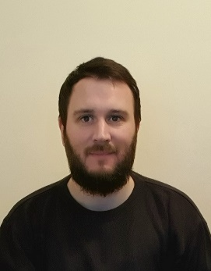

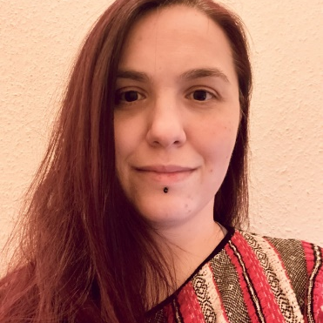
Our team working with you
Programme Delivery
Subject Matter Expertise
Analytics and Modelling
Client Assurance
Peter Lister
Programme Lead
Hilary Thompson
Finance
Chiara Bo
Analytics Architect
Rachel Helmn
National Integration Lead
Jane Boyle
Project Lead,
Programme Delivery
Dr David Hambleton
Clinical Integration
Dan Sanderson
Analyst
Jack Edmunds
Programme Delivery
Diana Tircommicu
Analyst

Slide 3
Your Programme
Initial Scoping
Engagement and Interviews
Planning Workshops
Strategy Development
NECS worked to establish the relationship between the Integrated Care System (ICS) and the localities through multiple avenues of stakeholder mapping
Interviews with key stakeholders were undertaken to inform the outputs from the programme of work being undertaken
Three workshops with each locality were devised to walk through the Yale approach to strategic problem solving. The outcome has been the identification of clear strategic priority areas
Working with the six localities, NECS is supporting development of strategic plans within each locality, accompanied by an overarching summary with recommendations for the ICS executive group.
Discovery
Design
Delivery

Slide 4
Eight Steps to Strategic Problem Solving – Yale University
Define the problem
Set a SMART objective
Conduct a root cause analysis
Develop a shared understanding of the problem
4. Develop alternative strategies
5. Compare possible strategies…
6. … and select one!
Move systematically towards a solution
7. Create an implementation plan
8. Create an evaluation plan
Execute

Slide 5
Applying the methodology
Inner City and East Bristol

Slide 6
Summary of Outputs
Working collaboratively, NECS has facilitated the Inner City and East Bristol locality through the Yale Strategic Problem Solving Model, to provide a framework and methodology for identifying and defining strategic priorities. Evidence shows that 93% of strategic plans fail within 12 months of their inception, and often this is as a result of devising solutions where the problem has not been thoroughly explored, or well articulated. Health and care staff often aim to provide solutions quickly to improve the lives of service users, but without thorough evidence, consideration or consultation, the solution proposed may not succeed.
Workshop One
  NECS highlighted key areas of focus within ICE Bristol based on PHM and JSNA data
  This information allowed the locality attendees to devise problem statements around the highlighted areas that are causing a significant issue within ICE Bristol
  These problem statements were then taken away and tested within the community, and taken back to a vote to determine which the key focus areas would be
  It is worth noting that the Yale Methodology should be used by the localities outside of this process to refine the other key areas focused on, to further tackle critical issues within the locality
Workshop Two
  Held within the community, undertaking a root cause analysis for each of the three prioritised problem statements, bringing together a wide-ranging group of stakeholders, ensuring that the community, healthcare, voluntary sector, people with lived experience and others were involved in the development of strategic priorities
  One key root cause was decided on for each problem statement, reflecting the opinions of stakeholders working within each priority area
Workshop Three
  Key interventions were determined within the Starting and Living Well areas, working from SMART objectives that were defined to establish clear strategies to tackling the problems refined in the first two workshops.

Slide 7
Workshop One
Workshop One saw the NECS Consultancy Analytics team, in collaboration with the BNSSG PHM Academy, highlight data that pointed to clear areas of priority within the locality. This data was mapped to the strategic focus areas set out, namely Starting Well, Living Well, and Ageing Well
The team present from Inner City and East Bristol were tasked with using that data to define problem statements, based on where they felt the issues highlighted were most impactful (long list contained on Slide 8).
These statements were then refined following Workshop One (slide 9), using the Locality Partnership team to truly test whether these statements were reflective of the population they aim to serve. Thus, commonalities within the first drafts were found, and a final list of three statements was devised.
In common with each of the other 5 localities, the workshop process with ICE Bristol followed a clear problem-solving approach, the Yale Methodology. The NECS Consultancy approach has provided a consistent offer to the Bristol, North Somerset, and South Gloucestershire population. This approach has been seen by those engaged in the workshops to be an effective means of determining priorities, and promotes being specific, focussed, and determining the true root cause of the issues that a team may be aiming to solve.

Slide 8
ICE Bristol Problem Statements – Long List
Number | Statement
1 | Vaccination take up in children in ICE is lower than BNSSG and National Average. Is this lower in particular communities
2 | ICE have the highest percentage of MH population engaged through secondary care within BNSSG
3 | There is potential under utilisation of diabetes community follow-up in the Asian community. Option to quote percentage from both ICB and National average if data is available
4 | ICE has the highest prevalence of unhealthy weight in Y6 children – highest percentage of childhood obesity of all localities in BNSSG
5 | ICE have a higher prevalence of severe frailty in over 75s in Asian and black communities in comparison to white communities. Could add data if required.
6 | The negative impact poverty in ICE has on children's ability to start well. Need to clarify what impact is of this (some indicators that may tell you why children aren't receiving a good start). E.g. high rates of anxiety within school age children from x IMD compared to Y could be significant root causes within this.
7 | In certain areas of ICE, more than 25% of children are leaving primary education obese.
8 | People from Asian backgrounds with diabetes are not accessing community care at the same rate as others
9 | People from Somali backgrounds repeatedly present to general practice with chronic pain. Problem is repeated consultation. Lots of chronic pain is given via prescribing data, and also through language to explain this community.
10 | Ethnicity data in ICE is incomplete. Impacts ability to articulate the problem that is seen.

Slide 9
ICE Bristol Problem Statements – Short List
Number | Statement
1 | ICE has the– highest percentage of childhood obesity in Y6 children of all localities in BNSSG (in some areas, more than 25% of children are leaving primary education obese)
2 | In ICE Bristol there are more contacts with secondary care Mental Health services in Black/ African/Caribbean/Asians compared to the white population (BNSSG QOF SMI register)
3 | Kingsdown and St Crofts has the highest age and sex standardised rate of people (217/100,000) who did not have a blood pressure reading suffering negative cardiovascular event in the whole of BNSSG (current average 100/100,000)
4 | ICE have a higher prevalence of severe frailty in over 75s in Asian and black communities in comparison to white communities

Slide 10
Workshop Two
Workshop Two saw the Inner City and East Bristol Locality Partnership team undertake root cause analyses of all of the four refined problem statements.
The NECS Consultancy team gave a recap of the Yale Methodology, to ensure that the Locality were truly exploring all possible root causes. It is worth noting that the group present contained a stakeholder group with specialist knowledge and interest in these areas, to make sure that all root causes alighted on are accurate, and representative of the communities within the Inner City and East Bristol Locality.

Slide 11
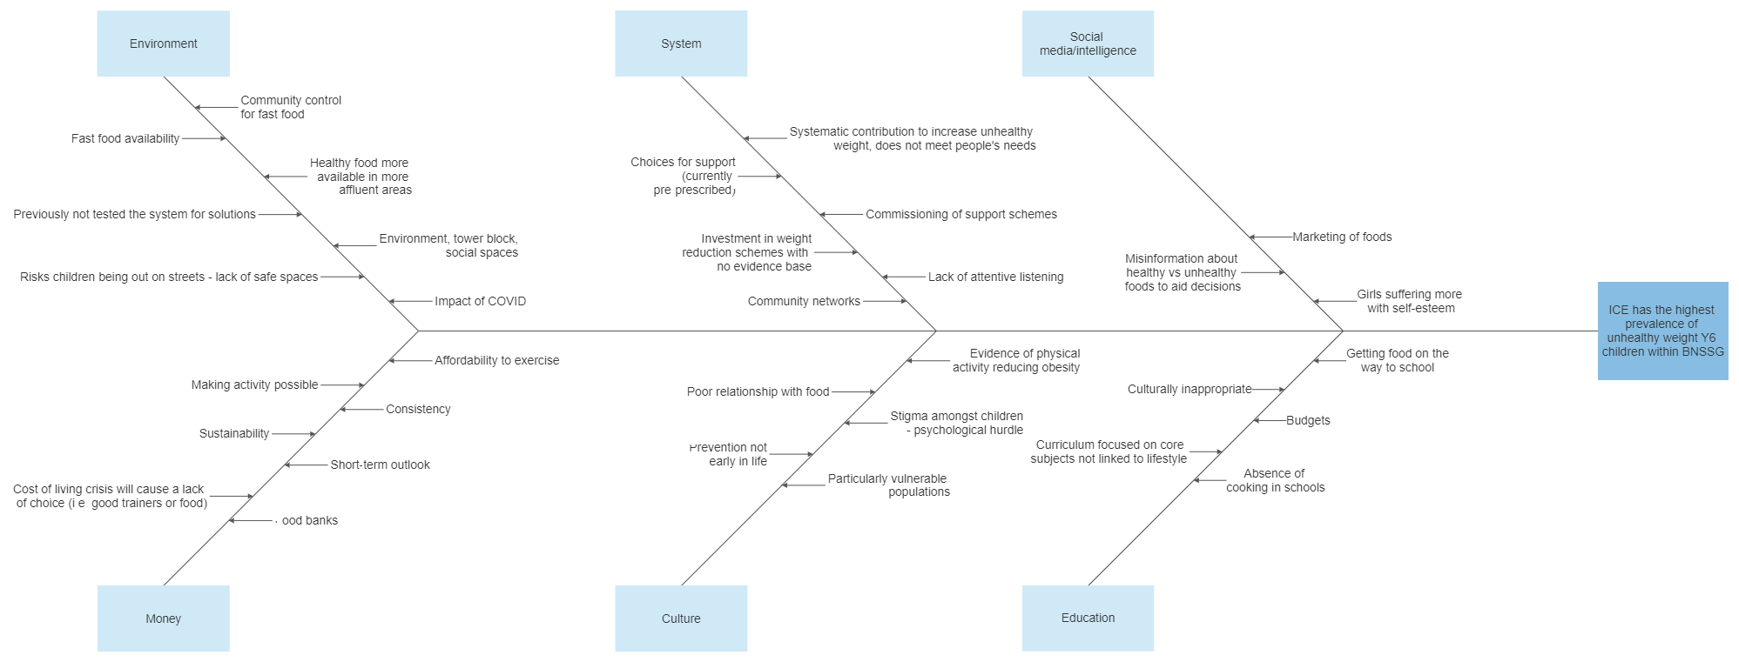
ICE has the highest prevalence of unhealthy weight in year six children

Slide 12
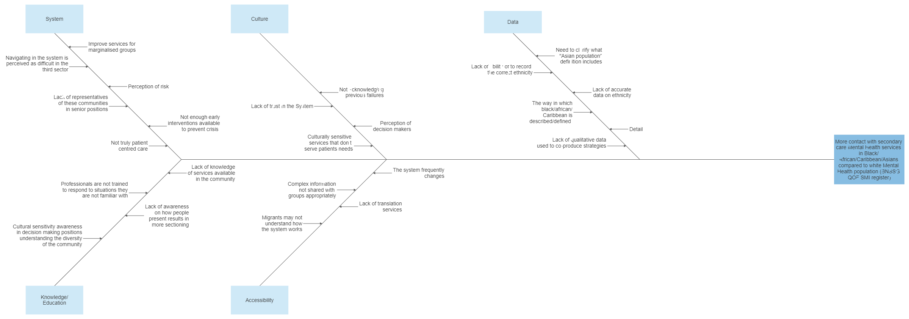
More contact with secondary care Mental Health services in Black/ African/Caribbean/Asians compared to white Mental Health population (BNSSG QOF SMI register)

Slide 13
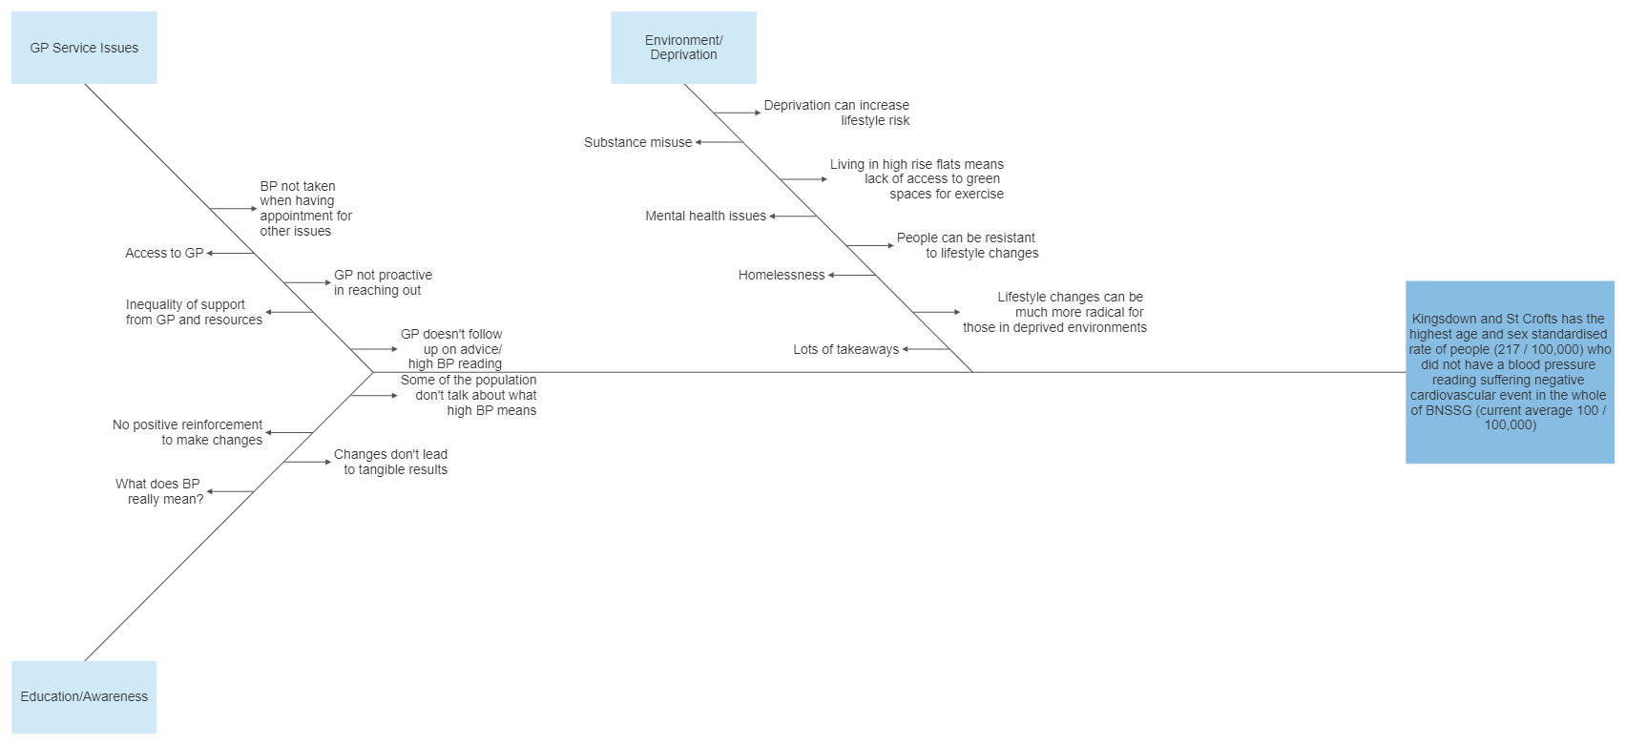
Kingsdown and St Crofts has the highest age and sex standardised rate of people (217 / 100,000) who did not have a blood pressure reading suffering negative cardiovascular event in the whole of BNSSG (current average 100 / 100,000)”.

Slide 14
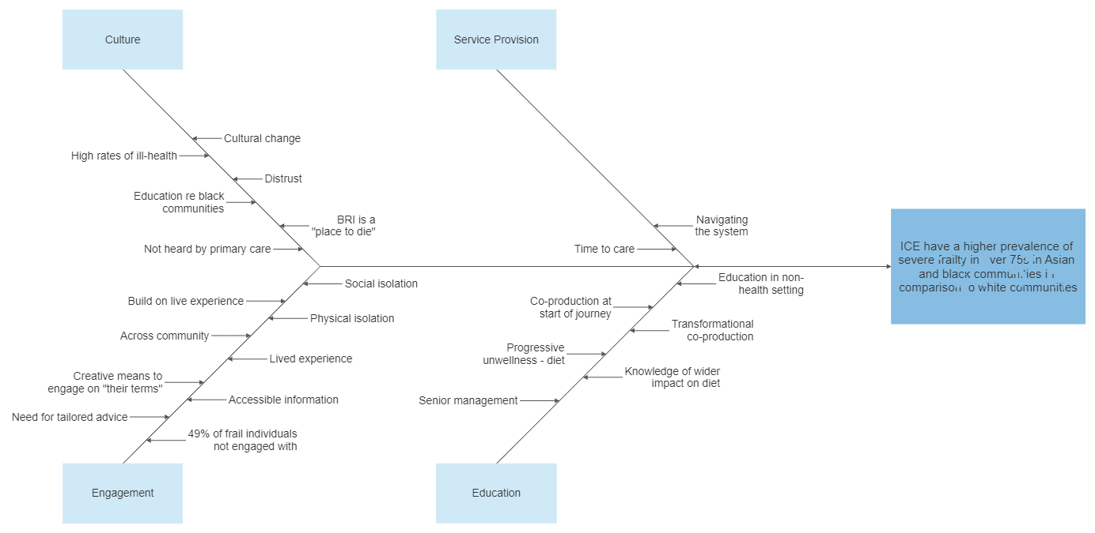
ICE have a higher prevalence of severe frailty in over 75s in Asian and black communities in comparison to white communities

Slide 15
Workshop Three
Starting Well and Living Well

Slide 16


Objective setting at workshop three
An expanded stakeholder group with subject matter experience undertook root cause analysis to identify SMART objectives, both for starting well and living well.
For this exercise, all ideas were captured and recorded in the language used by participants to ensure a fair representation of the discussion

Slide 17

Objective for Starting Well
Reduction in rate of obesity in Y6 children towards BNSSG overall rate, targeted to wards with the highest prevalence. Trajectory to be worked up as part of developing Locality Led Implementation

Slide 18

Strategy Development
It is recognised that there is existing work around childhood obesity being undertaken in Inner City and East Bristol, but those present at the workshop were encouraged to be creative in their strategy development, a snapshot of which included:
Community food groups/clubs on healthy eating
Using campaigns similar to those on the back of cigarette packets to highlight the impact of fast-food
Providing training and technical support to those who visit people in their own homes in a professional capacity to enable them to escalate falls risks (examples might include tradespeople)
Consensus, however, was overwhelmingly around one strategy:
Improvement of food environment through parents / schools, community food groups, gamification of healthy eating and children having the opportunity to grow vegetables

Slide 19
Objective for Living Well
Reduction in rate of people who did not have a blood pressure reading suffering a negative cardiovascular event towards BNSSG rate. Trajectory to be worked up as part of Locality Led Implementation

Slide 20
Strategy Development
It is recognised that there is existing work around living well being undertaken in ICE Bristol, but those present at the workshop were encouraged to be creative in their strategy development, a snapshot of which included:
Referencing the models used within the vaccination programme to push uptake in harder to reach communities
Providing language-specific support to tackle concerns around the healthcare system
Consensus, however, was overwhelmingly around one strategy:
A community focussed programme of work looking at taking blood pressure readings in familiar environments such as community centres, leisure centres, shopping centres; with links to primary care for follow up

Slide 21
Next Steps for South Bristol
Working with NECS Consultancy, the ICE Bristol locality are tasked with developing clear strategies for their remaining problem statements, regarding secondary care mental health services and severe frailty.
Once this process is completed, SMART objectives will be needed to be developed both of the remaining problem areas. It allows for a manageable number of initiatives being taken forward to 22/23 as the first stage of a five-year programme of planning and implementation.
NECS Consultancy will be supporting this process, and ensuring that a well articulated strategy is developed within the locality, mapping to each of the four problem areas.
The strategies will need to be measured against the four core purposes of an ICS (improving population health and healthcare; tackling unequal outcomes and access; enhancing productivity and value for money; and helping the NHS to support broader social and economic development), and a benefits realisation process will be carried out in order to reflect on the impact of each specific strategy.

Slide 22
Integrated Care Partnership Long-Term Plan
The outcomes of the approach outlined in previous slides will see strategic priorities developed over the next five years. This approach allows tangible success, and through the application of Population Health Management allows the solutions and interventions to be shaped by a sound understanding of the needs of the local community.
Ongoing work, led by the localities, over the next five years will enable the ten priorities originally selected to be reviewed on an annual basis and built in to a locality strategy and delivery plan which will be consulted on, and co-produced, with the local community.
By embedding the Yale methodology within each locality’s strategic thinking, NECS Consultancy will leave a robust methodology for problem solving.
This methodology champions collaboration and co-production, and provides a strong foundation for successful strategy development and implementation.

