Slide 1
NECS Consultancy Support to BNSSG
One Weston, Worle and Villages – Report to Locality Partnership Board
31/10/2022

Slide 2

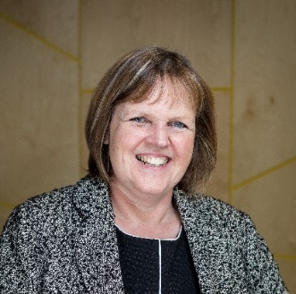


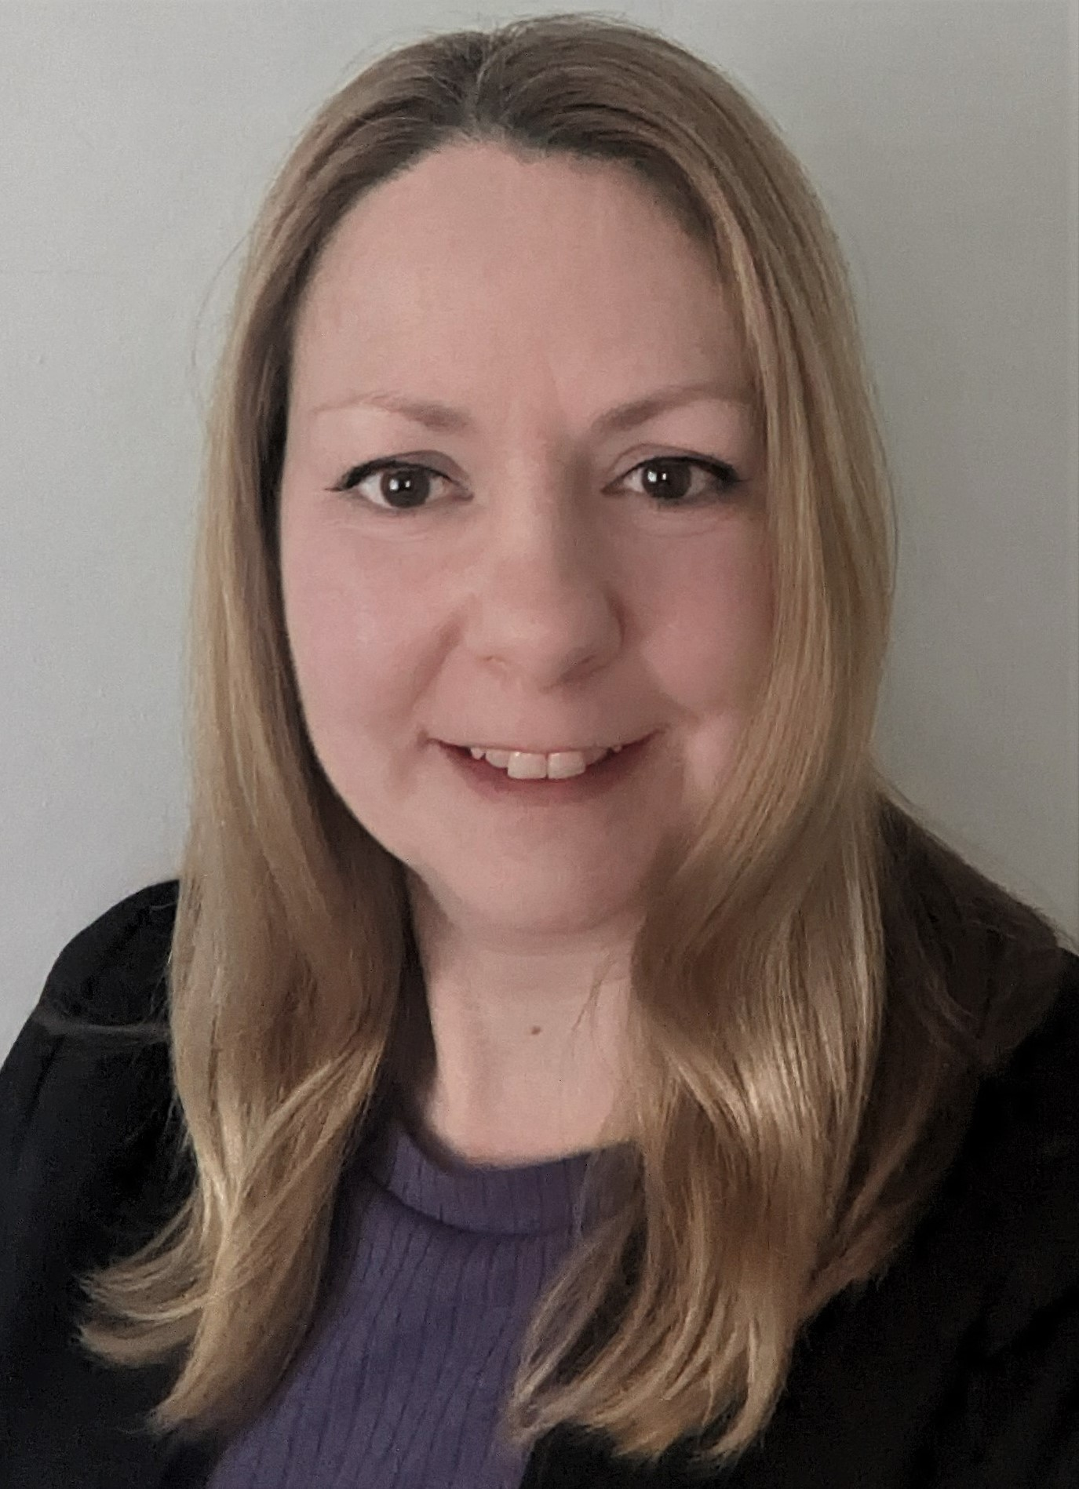

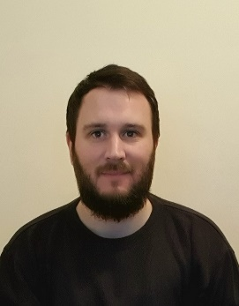

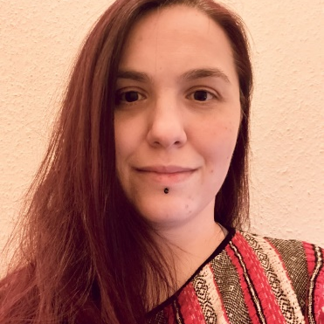
Our team working with you
Programme Delivery
Subject Matter Expertise
Analytics and Modelling
Client Assurance
Peter Lister
Programme Lead
Hilary Thompson
Finance
Chiara Bo
Analytics Architect
Rachel Helmn
National Integration Lead
Jane Boyle
Project Lead,
Programme Delivery
Dr David Hambleton
Clinical Integration
Dan Sanderson
Analyst
Jack Edmunds
Programme Delivery
Diana Tircommicu
Analyst

Slide 3
Your Programme
Initial Scoping
Engagement and Interviews
Planning Workshops
Strategy Development
NECS worked to establish the relationship between the Integrated Care System (ICS) and the localities through multiple avenues of stakeholder mapping
Interviews with key stakeholders were undertaken to inform the outputs from the programme of work being undertaken
Three workshops with each locality were devised to walk through the Yale approach to strategic problem solving. The outcome has been the identification of clear strategic priority areas
Working with the six localities, NECS is supporting development of strategic plans within each locality, accompanied by an overarching summary with recommendations for the ICS executive group.
Discovery
Design
Delivery

Slide 4
Eight Steps to Strategic Problem Solving – Yale University
Define the problem
Set a SMART objective
Conduct a root cause analysis
Develop a shared understanding of the problem
4. Develop alternative strategies
5. Compare possible strategies…
6. … and select one!
Move systematically towards a solution
7. Create an implementation plan
8. Create an evaluation plan
Execute

Slide 5
Applying the methodology
One Weston, Worle and Villages

Slide 6
Summary of Outputs
Working collaboratively, NECS has facilitated the WWV locality through the Yale Strategic Problem Solving Model, to provide a framework and methodology for identifying and defining strategic priorities. Evidence shows that 93% of strategic plans fail within 12 months of their inception, and often this is as a result of devising solutions where the problem has not been thoroughly explored, or well articulated. Health and care staff often aim to provide solutions quickly to improve the lives of service users, but without thorough evidence, consideration or consultation, the solution proposed may not succeed.
Workshop One
  NECS highlighted key areas of focus within WWV based on PHM and JSNA data
  This information allowed the locality attendees to devise problem statements around the highlighted areas that are causing a significant issue within WWV
  These problem statements were then taken away and tested within the community, and taken back to a vote to determine which the key focus areas would be
  It is worth noting that the Yale Methodology should be used by the localities outside of this process to refine the other key areas focused on, to further tackle critical issues within the locality
Workshop Two
  Root cause analysis was undertaken for each of the four prioritised problem statements, bringing together a wide-ranging group of stakeholders, ensuring that the community, healthcare, voluntary sector, people with lived experience and others were involved in the development of strategic priorities
  One key root cause was decided on for each problem statement, reflecting the opinions of stakeholders working within each priority area
Workshop Three
  Focussed on children and young people, with an aim to refine further the existing work that has been completed within the locality, including joint work with Woodspring, seeking a North Somerset solution to supporting people to “Die Well”

Slide 7
Workshop One
Workshop One saw the NECS Consultancy Analytics team, in collaboration with the BNSSG PHM Academy, highlight data that pointed to clear areas of priority within the locality. This data was mapped to the strategic focus areas set out, namely Starting Well, Living Well, Ageing Well, and Dying Well.
The team present from One Weston, Worle and Villages were tasked with using that data to define problem statements, based on where they felt the issues highlighted were most impactful (long list contained on Slide 8).
These statements were then refined following Workshop One (slide 9), using the Locality Partnership team to truly test whether these statements were reflective of the population they aim to serve. Thus, commonalities within the first drafts were found, and a final list of four statements was devised.
In common with each of the other 5 localities, the workshop process with One Weston, Worle and Villages followed a clear problem-solving approach, the Yale Methodology. The NECS Consultancy approach has provided a consistent offer to the Bristol, North Somerset, and South Gloucestershire population. This approach has been seen by those engaged in the workshops to be an effective means of determining priorities, and promotes being specific, focussed, and determining the true root cause of the issues that a team may be aiming to solve.

Slide 8
WWV Problem Statements – Long List
Number | Statement
1 | A higher prevalence of poor healthy eating, unhealthy weight and below average physical activity rating amongst Children and Young People across North Somerset.
2 | North Somerset has a higher than average presentation of children and young people with substance and alcohol use to our emergency departments
3 | An increase in children and Young people in North Somerset are missing key developmental transitional milestones in their young lives
4 | Children who live in poverty are twice as likely to be affected by trauma, they may be born early and small, suffer chronic diseases such as asthma, be abused, and face greater risk of mortality in early and later life because of this trauma
5 | Weston’s most deprived neighbourhoods have a lower life expectancy compared to other areas, this is also reflected in higher levels of mental health issues, unhealthy weight and lower physical activity
6 | Incidents of depression and dual diagnosis is higher than the South West Average with a significant amount of Mental health issues being located in the most deprived areas of Weston
7 | Weston has a higher percentage of the over 65’s in care homes compared to the national average and above average excess winter deaths
8 | Care home residents with dementia create a bigger demand on acute services than those residents who have continued to live in their own home with support
9 | Falls and frailty incidents prevention and clearer pathways of support to reduce demand on primary care services alongside limited utilisation of new technology
10 | Too many people die in hospital rather than their preferred setting of care

Slide 9
WWV Problem Statements – Short List
Number | Statement
1 | There is a higher prevalence of children and young people who are an unhealthy weight and have a below average physical activity across Weston, Worle and Villages
2 | Weston Worle and Villages most deprived areas have a lower life expectancy
3 | Demand from fall and frailty incidents across primary care
4 | Too many people die in hospital rather than their preferred setting of care

Slide 10
Workshops Two and Three
Between the second and third workshops, the team from One Weston, Worle and Villages were tasked with determining the key root cause of each of the problem statements defined through the first stage of the process. By utilising the Yale Methodology, it allows the clear root causes to be determined, and thus allows for specific objectives to be developed.
The following slides outline the work that has been completed by the WWV team to determine the root causes of each problem statement and then, through collaborative working, allowing the selection of meaningful and impactful root causes. Note that the RCA for “Dying Well” is to be completed by the locality team in partnership with Woodspring.
Focussing particularly on “Ageing Well”, WWV will need to build on the work currently completed with stakeholder groups, to refine a clear problem statement and causation regarding falls and frailty, using the Yale Methodology to get to an objective statement and strategy.
Following this, developing SMART objectives for the remaining problem statements and root causes is key to creating strategies that meet the needs of the individuals living in One Weston, Worle and Villages.

Slide 11
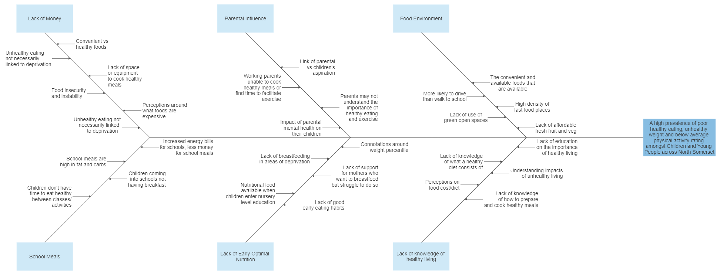
Root Cause Analysis – Starting Well

Slide 12
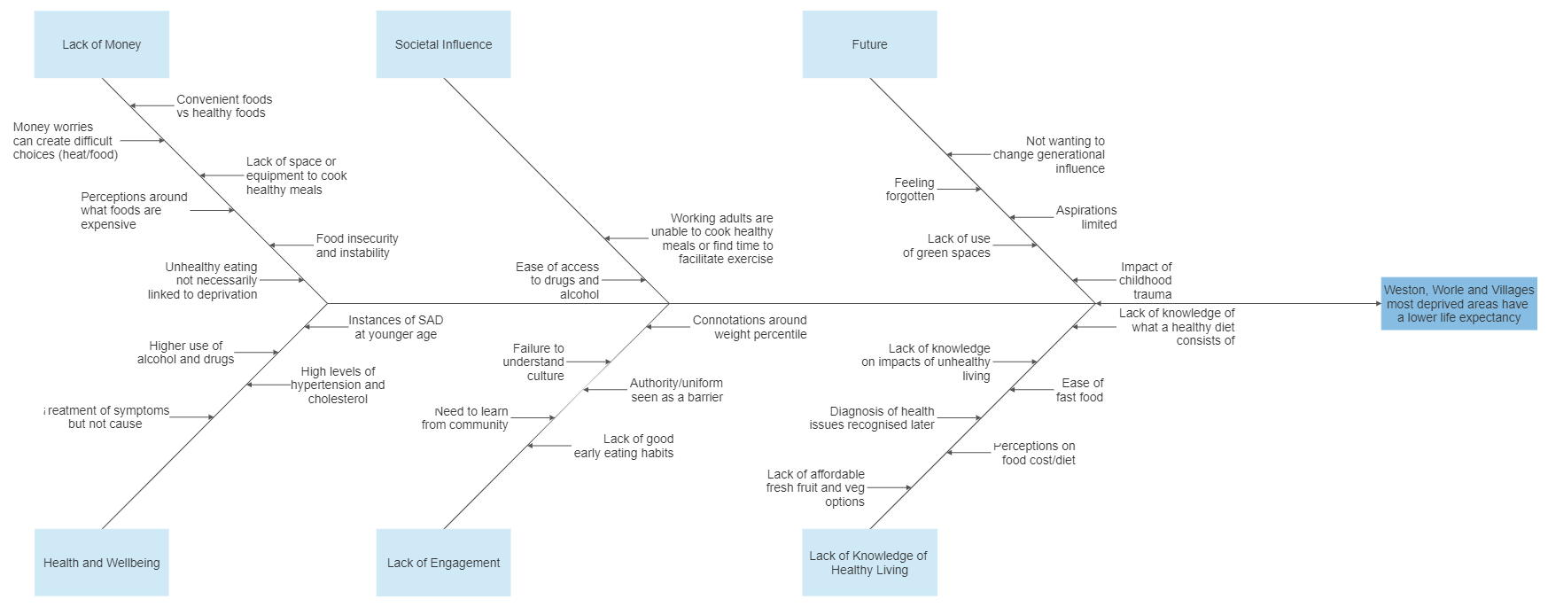
Root Cause Analysis – Living Well

Slide 13
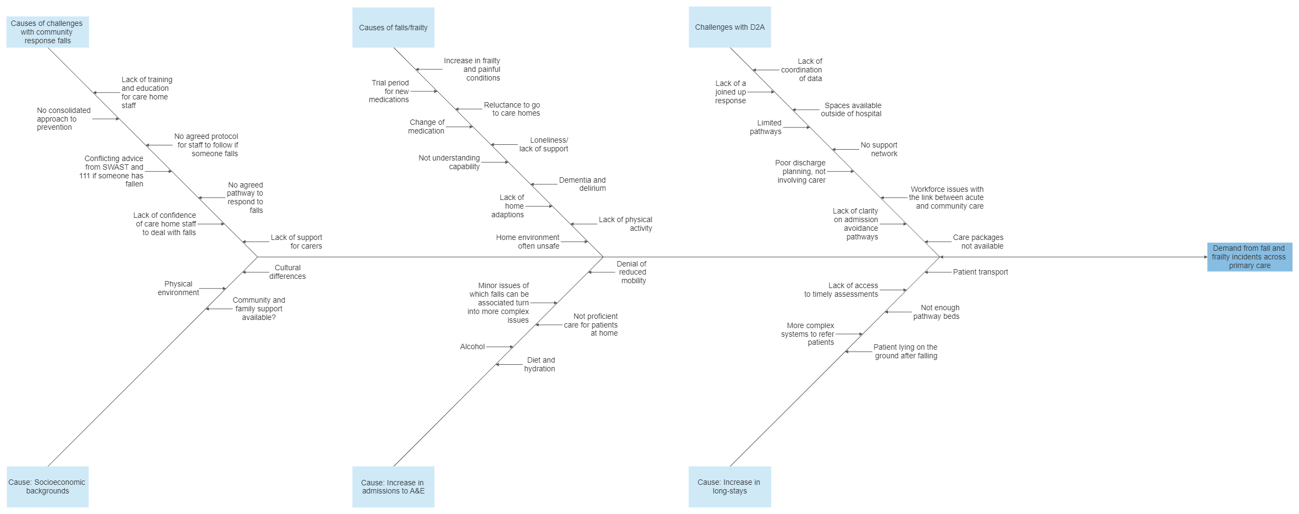
Root Cause Analysis – Ageing Well

Slide 14
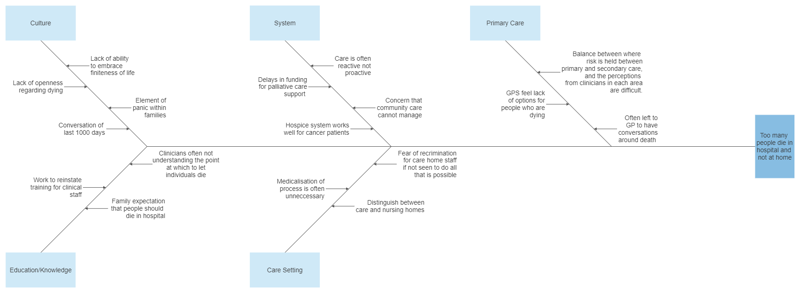
Root Cause Analysis – Dying Well

Slide 15
Next Steps for One Weston, Worle and Villages
Working with NECS Consultancy, the WWV locality are tasked with developing clear strategies for their problem statements in starting, living, ageing, and dying well.
Additional work needs to be undertaken to deliver clear outcomes in all remaining areas. Refinement of the problem statements is required, and establishing the clear root cause of all is still to be completed. A system for the locality to develop solutions to these problem statements is under consideration, to facilitate the locality to undertake this process.
Once this process is completed, SMART objectives will be needed to be developed for all four problem areas. It allows for a manageable number of initiatives being taken forward to 22/23 as the first stage of a five-year programme of planning and implementation.
NECS Consultancy will be supporting this process, and ensuring that a well articulated strategy is developed within the locality, mapping to each of the four problem areas.
The strategies will need to be measured against the four core purposes of an ICS (improving population health and healthcare; tackling unequal outcomes and access; enhancing productivity and value for money; and helping the NHS to support broader social and economic development), and a benefits realisation process will be carried out in order to reflect on the impact of each specific strategy.

Slide 16
Integrated Care Partnership Long-Term Plan
The outcomes of the approach outlined in previous slides will see strategic priorities developed over the next five years. This approach allows tangible success, and through the application of Population Health Management allows the solutions and interventions to be shaped by a sound understanding of the needs of the local community.
Ongoing work, led by the localities, over the next five years will enable the ten priorities originally selected to be reviewed on an annual basis and built in to a locality strategy and delivery plan which will be consulted on, and co-produced, with the local community.
By embedding the Yale methodology within each locality’s strategic thinking, NECS Consultancy will leave a robust methodology for problem solving.
This methodology champions collaboration and co-production, and provides a strong foundation for successful strategy development and implementation.

