Slide 1


Woodspring
2023-2028
What we can achieve together

Slide 2
What we can achieve together
If we are serious about promoting better health and wellbeing and addressing health inequalities, we must take collective decisions based on a shared understanding of the local population and how people live their lives. We must look beyond health and care services to the wider determinants that influence the health of our populations – early years support, housing, leisure, transport, skills and education, employment support and the environment
Thriving Places, September 2021
Jan 2023
Woodspring Locality Partnership define the root causes for living well and ageing well problem statements
Jan 2022
ICS signs of 6 Locality Partnership footprints
Sept 2022
Woodspring Locality Partnership agrees defines 4 problem statements
2018
Six Locality Partnerships were formed
March 2020 Coronavirus pandemic declared
2016
Bristol, North Somerset and South Gloucestershire (BNSSG) Healthier Together was formed to help partners work together
July 2022
BNSSG Integrated Care System (ICS) became a legal body
Feb 2023
Woodspring Locality Partnership agree the approach to identified priorities
February 2022
We publish this plan to set out what we are going to do and how
Oct 2022
Woodspring locality workshop the root causes for starting well and dying well

Slide 3
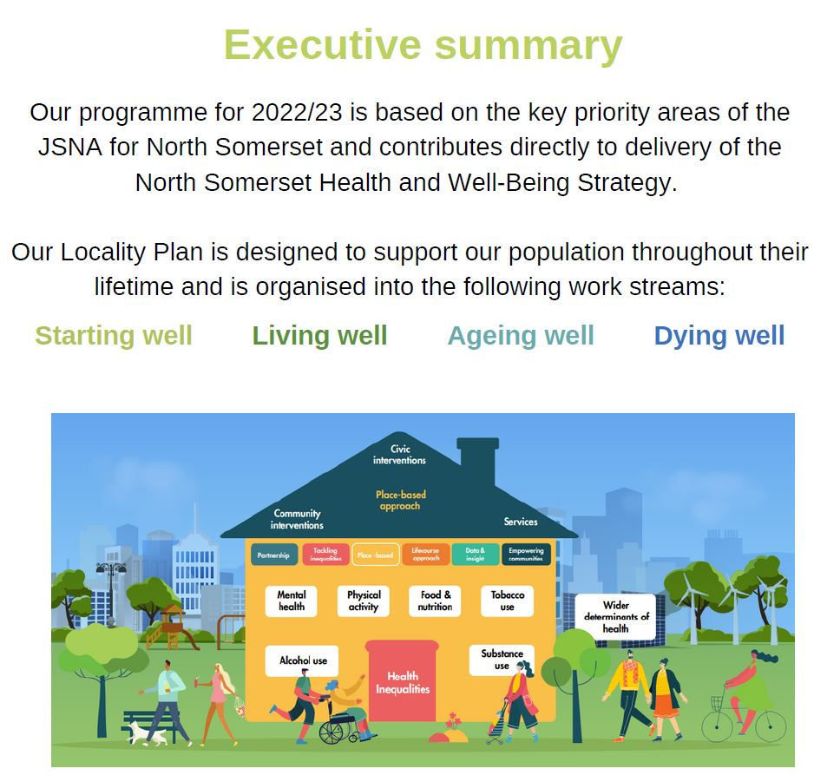

Slide 4
Introduction
Woodspring Locality Partnership brings together GPs, hospitals, mental health, social care, voluntary organisations and charities to deliver meaningful care and support that enables individuals and communities in Woodspring to optimise their own wellbeing.
In the past services have tried to deliver change at regional or national level. Our partnership has the advantage of working across a smaller area where local community organisations and people can help us to deliver change in the place they live and work. Listen to our North Somerset Partnership Podcast to hear more from those involved here
This plan outlines our priorities for 2023-2028. It has been developed by members of local health and social care workforce and local voluntary organisations. It is informed by their understanding of how we can change the way we work to meet local needs and of the people they work with.
We have started with the basic premise that if we try to do everything, we won’t deliver effective change. Instead, together we have reviewed the evidence we have and agreed four areas of focus for the coming years –
anxiety in young people, people living with pain, isolation in older age and having the last 1000 days end of life conversation.
We will build on what we have already achieved and focus on achieving the improvements we set out in this plan in the next five years. In addition we will grow the partnership
Through improving the experiences and outcomes will help people in Woodspring to live well and it will ensure our services are better able to support people when they are not well. We have developed our priorities collaboratively and we are collectively responsible for working together to achieve our goals and vision and to solve the problems we face.
What we can achieve together

Slide 5

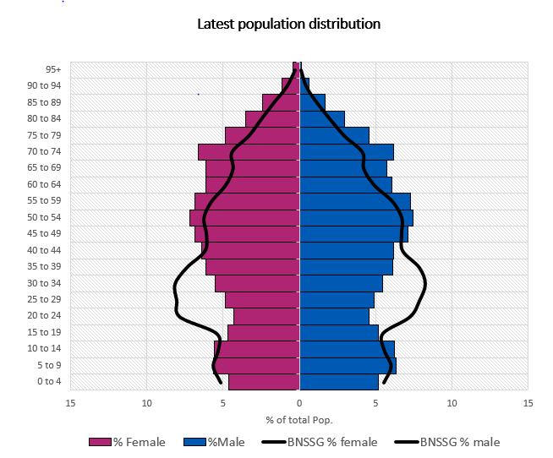

Woodspring demographics
131,140
Registered population
Large elderly population living
in their own homes with frailty
Much lower percentage of 15-44 year olds than BNSSG average
23% of the population aged 65 and over, double the percentage of the Bristol localities

Slide 6
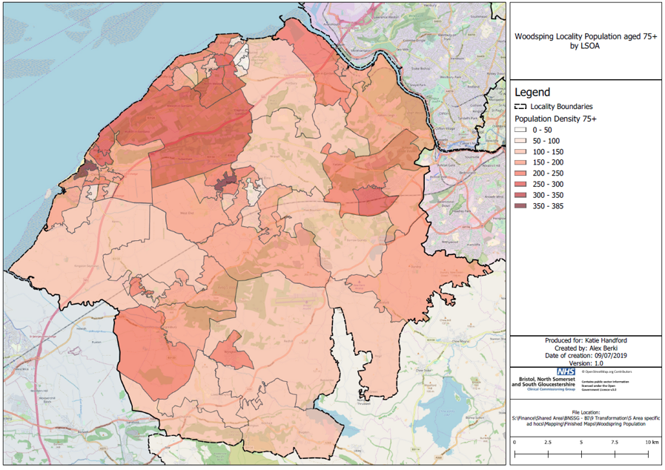
Woodspring Challenges
Social Isolation
Rurality
Large frail elderly population living at home
Poor public transport links
Domiciliary care access issues
Lack of lower level CYP mental health services

Slide 7
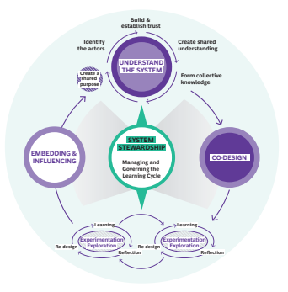
Approach
A Woodspring Human Learning System
• We understand the System (that produces the outcome we’re looking for)
• We Co-Design experiments/explorations
(to get that system to produce different outcomes)
• We Experiment /explore
• We Embed & influence (from the results of the explorations/experiments)
• We Manage and govern Learning Cycles (System Stewardship)
https://www.humanlearning.systems/

Slide 8
Asset-based – using the resources we have
We recognise people and communities bring skills and assets which can be shared across our community. In Woodspring we focus on ‘what is strong, not what is wrong’ and how services can only ever be part of the solution.
Woodspring has a rich tapestry of Community Connectors, Social Prescribers and volunteers supporting the growing numbers of individuals who have become increasingly visible because of the pandemic and cost of living crisis. The reliance and expectation that everyone can access everything they need online, or via an app, is unrealistic, and particularly affects older, less able and socially isolated people of Woodspring.
Community Connectors provide an actual person for individuals to talk to in their community to help them access local resources to improve wellbeing and to prevent their health deteriorating to the point of needing the support of health and social care agencies. We are also recruiting to a Community Development and Innovation post as part of our local response to the Fuller report. The post will support an ambitious and joined-up approach to prevention.
Woodspring Partnership is committed to connecting funding streams to the oversubscribed community offers in a way that makes sense, is light touch and meets statutory service requirements.

Slide 9






Accessing Woodspring’s community assets
PEOPLE
PLACES
From NHS/ health/ wellbeing support/ community development backgrounds....
Can be physical or virtual place...
Health / wellbeing
TRIAGE
Signposting
VCFSE sector
ABCD - Community + capacity development
Space, activity & services provision
Word of mouth
Travel
Agents
Word of mouth
Resident/ Client
Health / wellbeing SUPPORT
Guiding & hand holding
Brochures
Brochures
Start / Trigger
Holiday
Reps
Health / wellbeing SUPPORT
Complex support
Local knowledge
Holiday
planning
Where to go / what interests are
Local knowledge
Tour
guide
Destinations
Experience
Experience
Health/ wellbeing
OUTCOMES DELIVERY
Community based support
Health / wellbeing JOURNEY
Access as/ when required
Independent
traveller
Preparation & resilience to start/ continue/ progress Social Prescribing journey
Looking for ideas/ listening to suggestions/ taking action

Slide 10
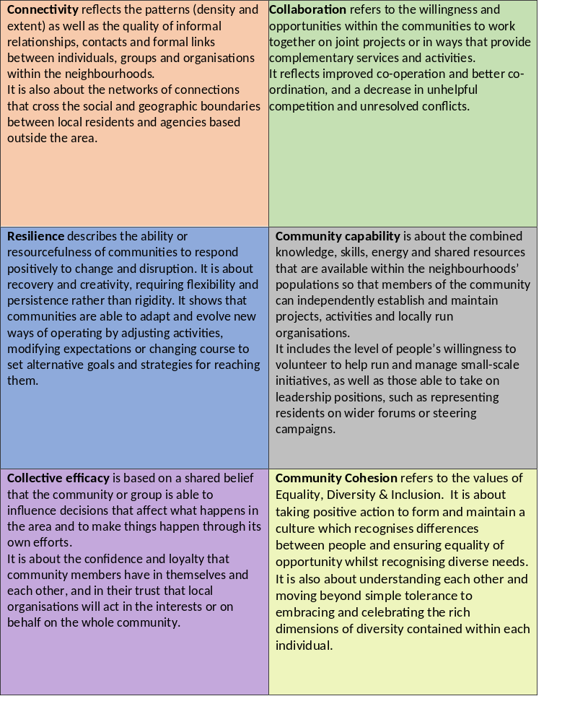
Outcomes for Communities
Based on a framework designed and developed by Alison Gilchrist and Our Neighbourhood April 2020
What we can achieve together

Slide 11
Health
Reducing inequalities
We are using our population health intelligence to identify our pockets of deprivation
We are developing an Anticipatory Care model to help people to live well and independently for longer through proactive care for those at high risk of unwarranted health outcomes.
That will involve structured proactive care and support from a multidisciplinary team (MDT).
We are determined to work with patients differently and to offer proactive well being and care interventions to improve or sustain their health, and to avoid reliance on unplanned care and the distress caused by emergency admissions to hospital.
What we can achieve together

Slide 12

How have lived experience representatives been involved in the Community Mental Health Programme?
Attending meetings and events, from their inception, as equal partners alongside others present, as part of co-production, we represent the views and experiences of both ourselves and others in contributing to the development of mental health support in the best interests of those who may need it. As part of the collaborative process, we listen to other points of view, and when appropriate share our personal lived experience to provide insight. We use our lived experience to influence the outcome and help the ongoing life and direction of the projects.
What has the experience been like?
‘’Being involved in the Woodspring ICP I have felt an equal part of the team. When I have something to say, I am heard, and my points are valued.’’
What we can achieve together

Slide 13
Evidence into Practice – Advisory Group
We have brought together our intelligence across the Joint Strategic Needs Assessment, produced by North Somerset Council’s public health team, to inform our priorities for 2023-28.
That assessment and the work of the Population Health Management team at the Integrated Care Board ensures our work is responsive to the needs of our population.
We have also worked with organisations across Woodspring to ensure that the data reflects the reality of what they experience every day working in the area.
As we begin to work to our priorities our Advisory Group will support our continuous learning approach to improve outcomes within our complex system
What we can achieve together

Slide 14
The problems we will focus on tackling
Domain | Problem Statements | Root Cause
Starting Well | Increased levels of anxiety in CYP in our communities are causing problems for schools, families and services | Communities are not able to support low level worries
Living Well | 3,000 people (2.3% of the population) aged between 50-74 living in Woodspring suffer from painful conditions. This has both social and health implications for individuals with a limited community service offer causing people to bounce between services. | On Forward Plan to refine Problem statement and undertake, RCA undertaking and SMART objective
Ageing Well | Older people’s confidence to go out post pandemic has reduced leaving them at a higher risk of falls and social isolation | On Forward Plan to refine Problem statement and undertake, RCA undertaking and SMART objective
Dying Well | Too many people die in hospital and not at home. | Not enough of our population are having the last 1000 days conversation
What we can achieve together

Slide 15
Starting well
Increased levels of anxiety in our communities are causing problems for schools, families and services
Evidence
Two school focus groups for children in year 7 to year 12 were undertaken in 2019
Self-harm Admissions for ages 10-24 increased from 71 in 2017/18 to 114 in 2020/21
Goal
Reduce the number of people presenting with anxiety into our statutory services
Approach
To be workshopped on Tuesday 31st January

Slide 16
Living well
Support people to manage their Pain in the community
Evidence
3,000 people (2.3% of the population) aged between 50-74 living in Woodspring suffer from painful conditions. This has both social and health implications for individuals with a limited community service offer causing people to bounce between services.
Comorbidity with pain and depressions
Goal
Year 1 priority will be to implement our full integrated Mental team Spring 2023
Approach
To be workshopped on Tuesday 17th January

Slide 17

Patient Story: Community Mental Health
John is a 65 year single man with learning difficulties. He has worked his whole life as a manual laborer. His mother, who was his career, died a few years ago. He went to his GP because he was feeling anxious and depressed. He told his GP that he didn’t have any family locally and he was feeling lonely. His GP referred him to a Community Navigator under the Community Mental Health Team.
The Community Navigator discovered that John’s home was in a poor state, the garden was overgrown, and there were piles of rubbish in most of the rooms. The house was in need of clearing, a deep clean and repair. The gas and electricity had been cut off and there were bundles of unopened post including an enforcement notice from the Local Authority for non-payment of Council Tax putting John at risk of losing his home
John needs the following support:
Mental Health Community Support
NSC Housing Advice Team
Adult Social Services Single Point of Access / Safeguarding
Citizens Advice: housing advice / benefit advice / debt advice
Alliance / Curo – support worker
Social Prescribing
Frontline health care professionals are constrained by time, understanding and social solution to know that John would need all of this support and who would you turn to.
What we can achieve together

Slide 18
Ageing Well
Reduce loneliness and Isolation
Evidence
Goal
Year 1 priority will be to implement anticipatory care and enhanced health in care homes under ageing well.
Approach
To be workshopped on 15th December

Slide 19
Dying Well
Too many people Die in Hospital
Evidence
When residents have completed End of Care Plans with their GP 50% die at home compared to 30% for those who have not.
The pioneer of the Compassionate Communities approaches Professor Allan Kellehear identified the 95% rule. A person living at home with a life-limiting illness may come into contact with statutory services up to 5% of any day. He asks the question, ‘as a community, what can we do to occupy that 95%?’
Goal
To support more last 1000 days discussions across our communities
Approach
Agree how our partnerships can support any existing, or the development of, ‘a tribe’ of those interested in the benefits of improving death literacy and associated support such a personalised care planning.
Our want being to contribute to, or bring together communities and professionals locally in North Somerset to follow the energy and interest on this subject to improve death literacy and support to allow them to design their activities.
We have identified the capacity constraints in our statutory professionals ability to enable a conversation in busy 10 minute appointments, explicitly responding to when the person is ready. We have recognised a need/want to be able to access compassionate people with space and skills to support those ready to make their plans.
We know this is good for people, our communities and so very pressured statutory services .

Slide 20
Delivery and implementation
Our delivery plans will respond to the feedback we have received from professionals and from people in our community – support provided needs to be sustainable.
Our plan will also need to be realistic. The impact of Covid-19 on health and wellbeing and more recent impact of the rising cost of living has been devastating for communities. It has also left capacity across our organisations strained. We must work to reduce those impacts on our community and on the people who live in and work in Woodspring.
We will strive to innovate, to increase capacity and to deliver sustainable solutions which are co-designed with communities. We will take a phased approach to give us time to deliver intelligent and joined up care to people who need it and to utilise the capacity that change generates to focus on prevention.
What we can achieve together

